Slide 1
Chapter 4 The Enhanced
Entity-Relationship (EER) Model

Slide 2
EER Model
The ER model concepts are sufficient for representing many database schemas for traditional database applications, which mainly include data-processing applications in business and industry.
However, designers of database applications have tried to design more accurate database schemas that reflect the data properties and constrains more precisely
In this chapter, we describe features that have been proposed for semantic data models, and show hoe the ER model can be enhanced to include these concepts.

Slide 3
Outline
Subclasses, Superclasses and Inheritance
Specialization and Generalization
Constrains and Characteristics
Union

Slide 4
Subclasses, Superclasses and Inheritance
In many cases an entity type has numerous subgroupings of its entities that are meaningful and need to be represented explicitly because of their significance to the database application.
For example: EMPLOYEE may be further grouped into:
    SECRETARY, ENGINEER, TECHNICIAN, …
      Based on the EMPLOYEE’s Job
    MANAGER
      EMPLOYEEs who are managers
    SALARIED_EMPLOYEE, HOURLY_EMPLOYEE
      Based on the EMPLOYEE’s method of pay

Slide 5

Subclasses and Superclasses

Slide 6
Subclasses, Superclasses and Inheritance
We call each of these subgroupings a subclass of the EMPLOYEE entity type, and the EMPLOYEE entity type is called the superclass for each of these subclasses.
These are called superclass/subclass (as well as simply class/subclass) relationships:
  EMPLOYEE/SECRETARY
  EMPLOYEE/TECHNICIAN
  EMPLOYEE/MANAGER
  …
These are also called IS-A relationships
  SECRETARY IS-A EMPLOYEE, TECHNICIAN IS-A EMPLOYEE, ….

Slide 7
Subclasses, Superclasses and Inheritance
An Entity CANNOT exist in the database merely by being a member of a subclass; it must also be a member of the superclass
A member of the superclass can be optionally included as a member of any number of its subclasses

Slide 8
Subclasses and Superclasses Example
  A salaried employee who is also an engineer belongs to the two subclasses:
    ENGINEER, and
    SALARIED_EMPLOYEE
  A salaried employee who is also an engineering manager belongs to the three subclasses:
    MANAGER,
    ENGINEER, and
    SALARIED_EMPLOYEE
It is not necessary that every entity in a superclass be a member of some subclass

Slide 9
Subclasses and Superclasses

Slide 10
Subclasses, Superclasses and Inheritance
An important concept associated with subclasses is that of type inheritance
An entity that is member of a subclass inherits
  All attributes of the entity as a member of the superclass
  All relationships of the entity as a member of the superclass

Slide 11
Subclasses, Superclasses and Inheritance
Example:
  In the previous slide, SECRETARY (as well as TECHNICIAN and ENGINEER) inherit the attributes Name, SSN, …, from EMPLOYEE
  Every SECRETARY entity will have values for the inherited attributes
  Every SECRETARY entity will also keep all relationships

Slide 12
Outline
Subclasses, Superclasses and Inheritance
Specialization and Generalization
Constrains and Characteristics
Union

Slide 13
Specialization
Specialization is the process of defining a set of subclasses of an entity type
The set of subclasses is based upon some distinguishing characteristics of the entities in the superclass
  Example: {SECRETARY, ENGINEER, TECHNICIAN} is a specialization of EMPLOYEE based upon job type.

Slide 14
Specialization
It may have several specializations of the same superclass
Example: Another specialization of EMPLOYEE based on method of pay is {SALARIED_EMPLOYEE, HOURLY_EMPLOYEE}.
The subset symbol on each line connecting a subclass to ϵ indicates the direction of the superclass/subclass relationship

Slide 15
Subclasses and Superclasses

Slide 16
Specialization
  Attributes of a subclass are called specific or local attributes.
    For example, the attribute TypingSpeed of SECRETARY
  The subclass can also participate in specific relationship types.
    For example, a relationship BELONGS_TO of HOURLY_EMPLOYEE

Slide 17
Specialization
There are two major reasons for including class/subclass relationship and specialization in a data model:
1. Certain attributes may apply to some but not all entities of the superclass (secretary subclass has local attribute Typing speed where engineer has eng_type)
2. some relationship types may be participate in only by entities that are members of the subclass (Hourly_employees are related to Trade_nuion via velongs_to)

Slide 18
Specialization
In summary, the specialization process allows us to do the following:
  Define a set of subclass of an entity type
  Establish additional specific attributes with each subclass
  Establish additional specific relationship types between each subclass and other entity types or other subclasses

Slide 19
Generalization
Generalization is the reverse of the specialization process
Several classes with common features are generalized into a superclass;
  original classes become its subclasses

Slide 20
Generalization
Example: CAR, TRUCK generalized into VEHICLE;
  both CAR, TRUCK become subclasses of the superclass VEHICLE.
  We can view {CAR, TRUCK} as a specialization of VEHICLE
  Alternatively, we can view VEHICLE as a generalization of CAR and TRUCK

Slide 21

Generalization (2)

Slide 22
Outline
Subclasses, Superclasses and Inheritance
Specialization and Generalization
Constrains and Characteristics
Union

Slide 23
Constraints on Specialization and Generalization
Two basic constraints can apply to a specialization/generalization:
  Disjointness Constraint:
  Completeness Constraint:

Slide 24
Constraints on Specialization and Generalization
Disjointness Constraint:
  Specifies that the subclasses of the specialization must be disjoint: an entity can be a member of at most one of the subclasses of the specialization
Specified by d in EER diagram

Slide 25

Displaying an attribute-defined specialization in EER diagrams

Slide 26
Constraints on Specialization and Generalization
  If not disjoint, specialization is overlapping:
    that is the same entity may be a member of more than one subclass of the specialization
  Specified by o in EER diagram

Slide 27

Example of overlapping total Specialization

Slide 28
Constraints on Specialization and Generalization
Completeness Constraint:
  Total specifies that every entity in the superclass must be a member of some subclass in the specialization/generalization
  Shown in EER diagrams by a double line
  Partial allows an entity not to belong to any of the subclasses
  Shown in EER diagrams by a single line
  In general, a superclass that was identified through the generalization process usually total, because the superclass is derived from the subclasses and hence contains only the entities that are in the subclass

Slide 29
Constraints on Specialization and Generalization (6)
Hence, we have four types of specialization/generalization:
  Disjoint, total
  Disjoint, partial
  Overlapping, total
  Overlapping, partial

Slide 30
Constraints on Specialization and Generalization
Some general rules:
  Deleting an entity from s superclass implies that it is automatically deleted from all the subclasses to which it belongs
  Inserting an entity in a superclass of a total specialization implies that the entity is mandatorily inserted in at least one of the subclasses of the specialization

Slide 31
Specialization/Generalization Hierarchies, Lattices
A subclass may itself have further subclasses specified on it
Hierarchy has a constraint that every subclass has only one superclass (called single inheritance); this is basically a tree structure
In a lattice, a subclass can be subclass of more than one superclass (called multiple inheritance)

Slide 32

Shared Subclass “Engineering_Manager”

Slide 33
Specialization/Generalization Hierarchies, Lattices
Leaf node is a class that has no subclasses of its own
A subclass with more than one superclass is called a shared subclass (multiple inheritance)
Notice that the existence of at least one shared subclass leads to a lattice, otherwise, it’s a hierarchy

Slide 34

Specialization / Generalization Lattice Example (UNIVERSITY)

Slide 35
Outline
Subclasses, Superclasses and Inheritance
Specialization and Generalization
Constrains and Characteristics
Union

Slide 36
Union
All of the superclass/subclass relationships we have seen so far origin from a single superclass
Sometimes we may need more than one superclass
In this case, the subclass will represent a collection of objects that is a subset of the UNION of distinct entity types
We call such a subclass a UNION TYPE

Slide 37
Union
Example: In a database for vehicle registration, a vehicle owner can be a PERSON, a BANK (holding a lien on a vehicle) or a COMPANY.
  A UNION type called OWNER is created to represent a subset of the union of the three superclasses COMPANY, BANK, and PERSON

Slide 38
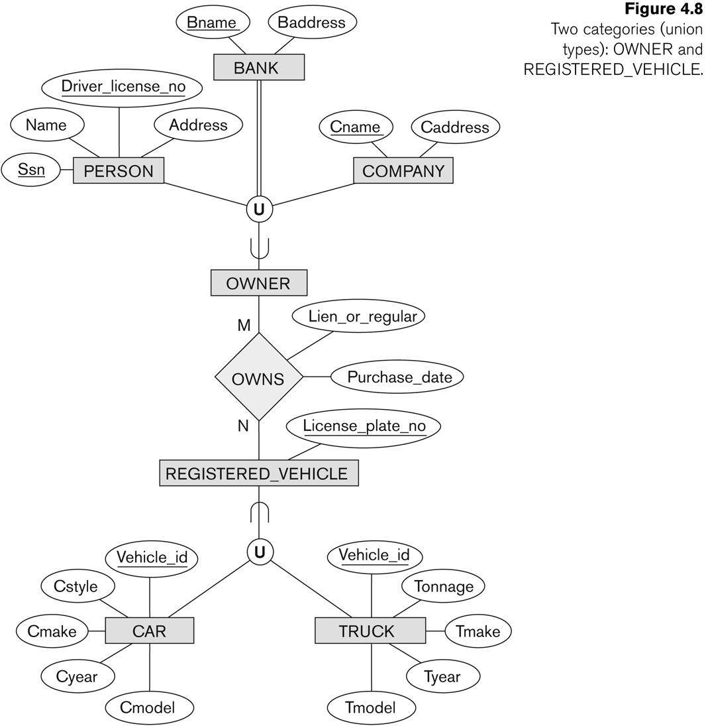
Two categories (UNION types): OWNER, REGISTERED_VEHICLE

Slide 39
Union
We can compare a UNION (OWNER) with shared subclass (ENGINEERING_MANAGER)
The latter is a subclass of each of the three superclass ENGINEER, MANAGER and SALARIED_EMPLOYEE, so an entity that us a member of ENGINEERING_MANAGER must exist in all three
This means that an engineering manager must be an ENGINEER, a MANAGER, and a SALARIED_EMPLOYEE
On the other hand, an entity that is a member of OWNER must exist in only one of the superclass

Slide 40
Shared Subclass “Engineering_Manager”

Slide 41
UNION
Attribute inheritance works more selectively in the case of UNION.
For example, OWNER entity inherits attributes of a COMPANY, a PERSON OR a BANK
A shared subclass such as ENGINEERING_MANAGER inherits ALL the attributes of its superclasses

Slide 42
Outline
Subclasses, Superclasses and Inheritance
Specialization and Generalization
Constrains and Characteristics
Union

